Slide 1
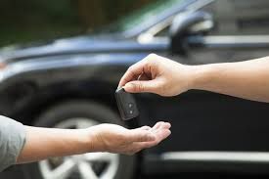
Lease Vehicles
Company Name:
Gateway Technolabs
Presentation By : Khushboo Raghani
Internal Guide: Dr. Devarshi Mehta

Slide 2
Introduction
Leasing is a solution for financing second-hand vehicles, with focus on various vehicles. The end user can visit the site and lease any of the vehicle, that are supported on our application. To confirm the vehicle for a lease, end user/customer has to do down payment amount (x amount), thereafter, the application will divide the monthly installment.
Different leasing parameters like Down payment percentage, lease duration etc.… will be calculated in the lease calculator and which will calculate the monthly lease amount.
It is an online system through which user can view available vehicles, register, view profile and book vehicles on the basis of category and brand as per the customer’s requirement

Slide 3
Proposed System
Some people cannot afford to have a vehicle, for those people this system becomes very helpful.
Lease vehicle system has a user interface that will allow their users to view the models, descriptions and prices of different vehicle available.
The user has the ability to register and log in to the Web App and track their rental plan. The Web App will be responsive, allowing for the user to view it on any device, from tablets to mobile phones and desktop computers.
This system includes various vehicle, as per the user order and comfort, it place the order for lease.
This system also provide friendly user interface of payment.

Slide 4
Objective
To produce a web-based system that allow customer to register and reserve vehicle online and for the company to effectively manage their leasing vehicle business.
To ease customer’s task whenever they need to rent a vehicle (on the basis of categories and brand).

Slide 5
Tools and Technology
Tools/Platform
IIS Server (Microsoft)
Visual Studio 2017 Community
Visual Studio Code
MS SERVER 2017
Browser (Chrome/Explorer/Firefox)

Slide 6
Technology
C#
ASP .NET MVC
Web API
MS Server 2017
HTML5
CSS3
Bootstrap
JavaScript
jQuery3.4.1

Slide 7
Minimum Hardware and Software Requirement Specification
Client Side
Software Requirements
OS: Windows 7 or above
Web-browser: Chrome/Explorer/Mozilla Firefox
Hardware Requirements
Processor: 2GHz
RAM: 2GB
Hard Disk: 2GB free space

Slide 8
Server Side
Software Requirements
OS: Windows 7 above
IDE: Visual Studio Community 2017
MS Server 2017
Web-browser: Chrome/Explorer/Mozilla Firefox
Hardware Requirements
Processor: 3GHz
RAM: 4GB
Hard Disk: 15GB free space

Slide 9
Future Scope
The system is also available for many cities.
The system will provide more vehicle category.
The system will provide Tracking service.
Price Calculator parameters will be extended.
The system will be multilingual site.

Slide 10
Users of System
Admin/Dealer
Admin is responsible for manage the user
Admin can track and modify the vehicle details.
Admin can manage payment details.
Admin can also manage the complain and feedback.
Admin can add and verify the documents.

Slide 11
User /Buyer
User can do registration and login.
User can view the vehicle details.
User can book the vehicle for specific period of time on rent.
User can add the documents for verification like driving license.
User can generate quotations and do payments.

Slide 12
UML Diagrams

Slide 13
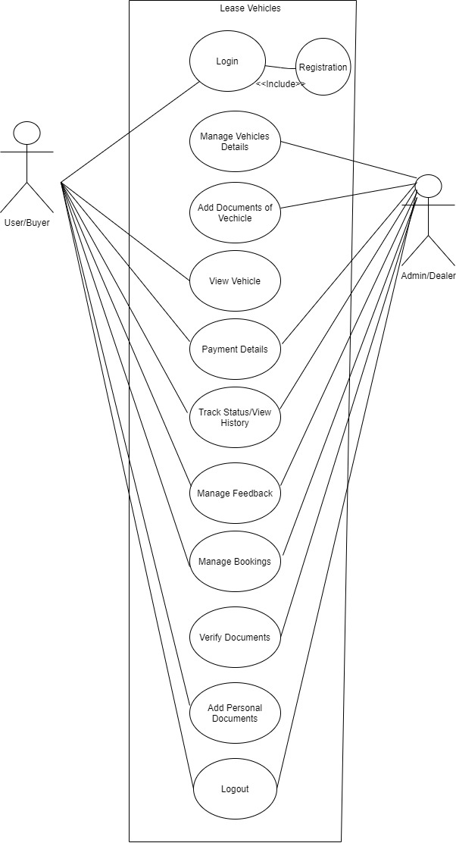
Use Case

Slide 14
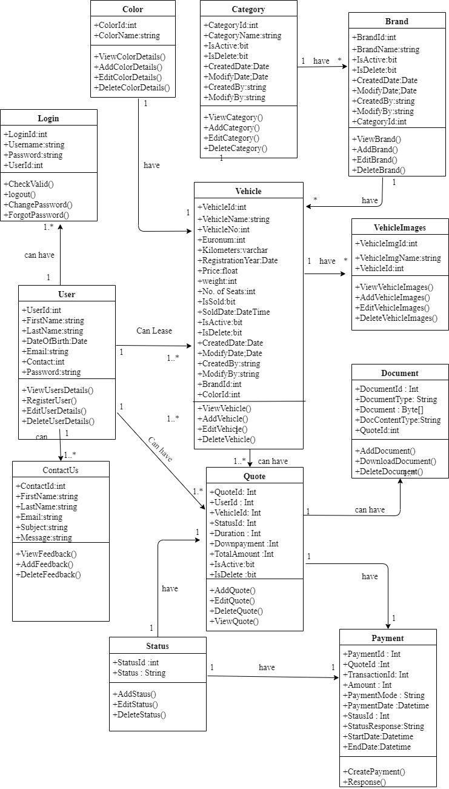
Class Diagram

Slide 15
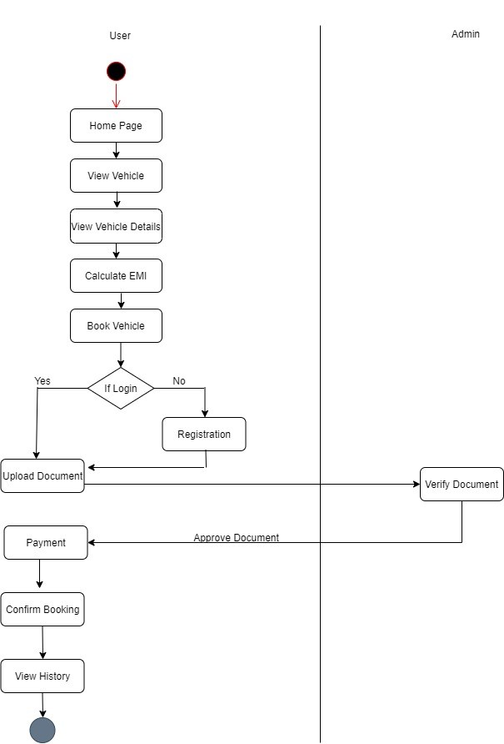
Activity Diagram
Add Vehicle

Slide 16
Data Dictionary
Login
Field Name | Data type | Length | Constraints | Null/Not Null | Description
LoginId | int | 8 | Primary Key | Not Null | LoginId
UserName | varchar | 50 | - | Not Null | Name of User
Password | varchar | 255 | - | Not Null | Password
IsActive | bit | - | Default:1(true) | Not Null | Stores status 1(Active) or 0(In Active)
IsDelete | bit | - | Default:0(false) | Not Null | Stores status true(Deleted) or false(Not Deleted)
LoginDate | Datetime | - | - | Not Null | Date and Time of login

Slide 17
Category
Field Name | Data type | Length | Constraints | Null/Not Null | Description
CategoryId | int | 8 | Primary Key | Not Null | CategoryId
CategoryName | varchar | 25 | - | Not Null | Category Name
IsActive | bit | - | Default:1(true) | Not Null | Stores status 1(Active) or 0(In Active)
IsDelete | bit | - | Default:0(false) | Not Null | Stores status true(Deleted) or false(Not Deleted)
CreatedDate | Datetime | - | Default : systemdate | Not Null | Date and Time of category added
ModifyDate | Datetime | - | - | Null | Date and Time of category modify
CreatedBy | varchar | 50 | Foreign Key | Not Null | Name of user that added category
ModifyBy | varchar | 50 | Foreign Key | Null | Name of user that modify category

Slide 18
Brand
Field Name | Data type | Length | Constraints | Null/Not Null | Description
BrandId | int | 8 | Primary Key | Not Null | Brand Id
BrandName | varchar | 50 | - | Not Null | Brand Name
IsActive | bit | - | Default:1(true) | Not Null | Stores status 1(Active) or 0(In Active)
IsDelete | bit | - | Default:0(false) | Not Null | Stores status true(Deleted) or false(Not Deleted)
CreatedDate | Datetime | - | Default : systemdate | Not Null | Date and Time of brand added
ModifyDate | Datetime | - | - | Null | Date and Time of brand modify
CreatedBy | varchar | 50 | Foreign Key | Not Null | Name of user that added brand
ModifyBy | varchar | 50 | Foreign Key | Null | Name of user that modify brand
CategoryId | int | 8 | Foreign Key | Not Null | Category Id

Slide 19
Color
Field Name | Data type | Length | Constraints | Null/Not Null | Description
ColorId | int | 8 | Primary Key | Not Null | Color Id
ColorName | varchar | 30 | - | Not Null | Color Name

Slide 20
Vehicle
Field Name | Data type | Length | Constraints | Null/Not Null | Description
VehicleId | int | 8 | Primary Key | Not Null | Vehicle Id
VehicleName | varchar | 50 | - | Not Null | Vehicle Name
VehicleNo | varchar | 50 | - | Not Null | Vehicle No like GJ01AS1234
CategoryId | int | 8 | Foreign Key | Not Null | Category Id
BrandId | int | 8 | Foreign Key | Not Null | Brand Id
ColorId | int | 8 | Foreign Key | Not Null | Color Id
Euronorms | int | 8 | - | Not Null | Stores value from 1 to 5.More the value latest the vehicle.
Kilometers | bigint | 15 | - | Not Null | Kilometers
Weight | float | - | - | Not Null | Weight
Registration year | Date | - | - | Not Null | Registration year of vehicle

Slide 21
Continue..
Vehicle
Field Name | Data type | Length | Constraints | Null/Not Null | Description
Price | float | - | - | Not Null | Price of Vehicle(In Rs.)
NoOfSeats | int | 5 | - | Not Null | No of Seats like 4,2 etc
IsSold | bit | - | Default:0(true) | Not Null | Stores status 1(Vehicle sold) or 0(Vehicle not sold)
SoldDate | Datetime | - | - | Not Null | Sold Date of vehicle
IsActive | bit | - | Default:1(true) | Not Null | Stores status 1(Active) or 0(In Active)
IsDelete | bit | - | Default:0(false) | Not Null | Stores status true(Deleted) or false(Not Deleted)
CreatedDate | Datetime | - | Default : systemdate | Not Null | Date and Time of vehicle added
ModifyDate | Datetime | - | - | Null | Date and Time of vehicle modify
CreatedBy | varchar | 50 | Foreign Key | Not Null | Name of user that added vehicle
ModifyBy | varchar | 50 | Foreign Key | Null | Name of user that modify vehicle

Slide 22
Vehicle Image
Field Name | Data type | Length | Constraints | Null/Not Null | Description
VehicleImgId | int | 8 | Primary Key | Not Null | Vehicle Image Id
VehicleImgName | varchar | 50 | - | Not Null | Vehicle Image Name like voterId.jpeg
VehicleId | int | 8 | Foreign Key | Not Null | Vehicle Id

Slide 23
User
Field Name | Data type | Length | Constraints | Null/Not Null | Description
UserId | int | 8 | Primary Key | Not Null | User Id
FirstName | varchar | 50 | - | Not Null | First Name of User
LastName | varchar | 50 | - | Not Null | Last Name of User
Email | varchar | 80 | - | Not Null | Email of User
Contact | varchar | 20 | - | Not Null | Contact of User
Password | varchar | 255 | - | Not Null | Password

Slide 24
ContactUs
Field Name | Data type | Length | Constraints | Null/Not Null | Description
ContactId | int | 8 | Primary Key | Not Null | ContactId
FirstName | varchar | 50 | - | Not Null | First Name of User
LastName | varchar | 50 | - | Not Null | Last Name of User
Email | varchar | 100 | - | Not Null | Email of User
Subject | varchar | 50 | - | Not Null | Subject
Message | varchar | 255 | - | Not Null | Message or Description

Slide 25
Status
Field Name | Data type | Length | Constraints | Null/Not Null | Description
StatusId | int | 8 | Primary Key | Not Null | Status Id
Status | varchar | 30 | - | Not Null | Accepted ,Rejected , Requested , Verified , etc.

Slide 26
Quote
Field Name | Data type | Length | Constraints | Null/Not Null | Description
QuoteId | int | 8 | Primary Key | Not Null | QuoteId
VehicleId | int | 8 | Foreign Key | Not Null | VehicleId
UserId | int | 8 | Foreign Key | Not Null | UserId
Duration | int | 4 | - | Not Null | Duration like 12 months,24 months etc.
Downpayment | int | 8 | - | Not Null | Downpayment like Rs.100000,Rs.50000,etc.
TotalAmount | bigint | 10 | - | Not Null | Calculation of Amount pay per month by user
StatusId | int | 8 | Foreign Key | Not Null | StatusId
Details | varchar | 100 | - | Null | Details stores reason for status like if document rejected reason will specified in details
IsActive | bit | - | Default:1(true) | Not Null | Stores status 1(Active) or 0(In Active)
IsDelete | bit | - | Default:0(false) | Not Null | Stores status true(Deleted) or false(Not Deleted)

Slide 27
Document
Field Name | Data type | Length | Constraints | Null/Not Null | Description
DocId | int | 8 | Primary Key | Not Null | DocId
DocName | varchar | 100 | - | Not Null | Name of Document like voterId.png
DocData | varchar | 255 | - | Not Null | Document data
DocContentType | varchar | 50 | - | Not Null | Type of Document like png,jpeg,etc.
QuoteId | int | 8 | Foreign Key | Not Null | QuoteId

Slide 28
Payment Details
Field Name | Data type | Length | Constraints | Null/Not Null | Description
PaymentId | int | 8 | Primary Key | Not Null | Payment Id
Amount | double | - | - | Not Null | Amount
QuoteId | int | 8 | Foreign Key | Not Null | Quote Id
TransactionId | int | 11 | - | Not Null | Unique transaction id generated by paytm(payment gateway)
PaymentMode | varchar | 50 | - | Not Null | Mode of payment like cheque,etc
StatusId | int | 8 | Foreign Key | Not Null | Status Id.
PaymentDate | datetime | - | - | Not Null | Date of payment
StatusReponse | varchar | 100 | - | Not Null | Store Details of Status.
StartDate | datetime | - | - | Not Null | Start Date of Installment
EndDate | datetime | - | - | Not Null | End Date of Installment

Slide 29
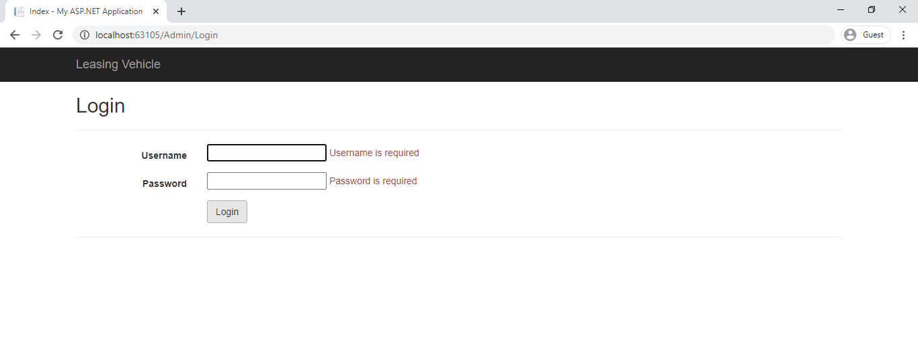
Screenshots: Admin Side
Form Validation
Admin side Login Page

Slide 30
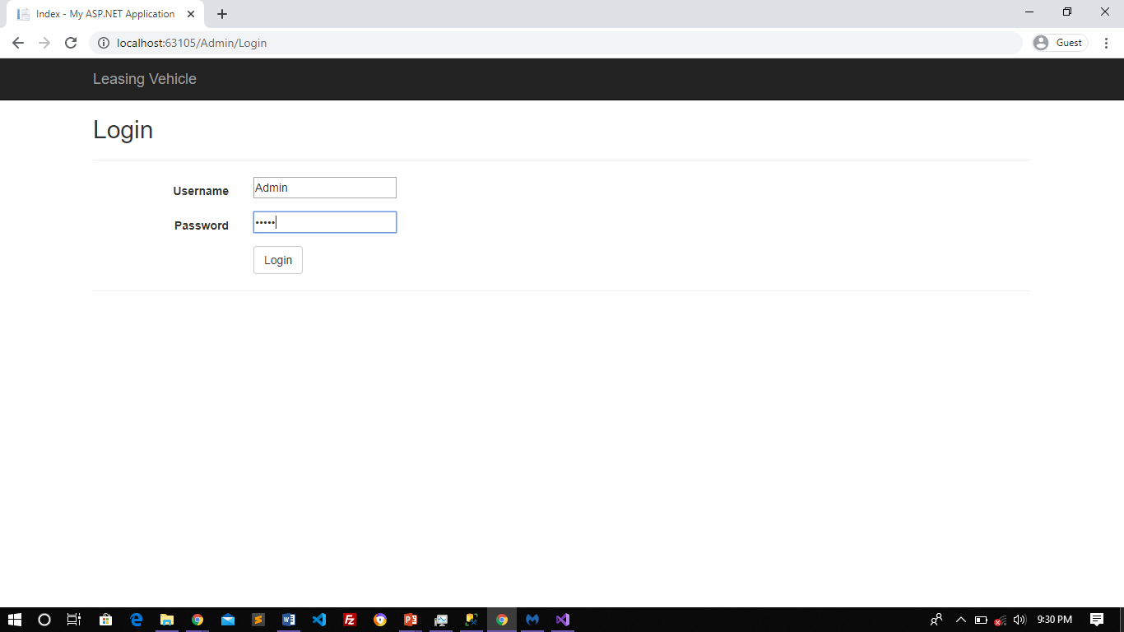
Required Fields
If Correct Credentials redirect
to Dashboard.

Slide 31
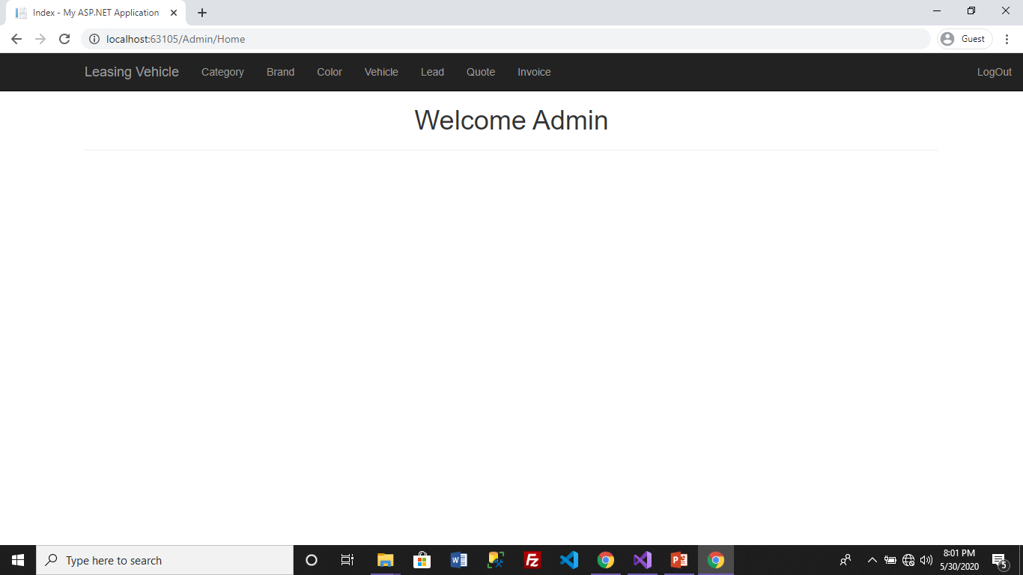
Dashboard
Admin side Dashboard

Slide 32
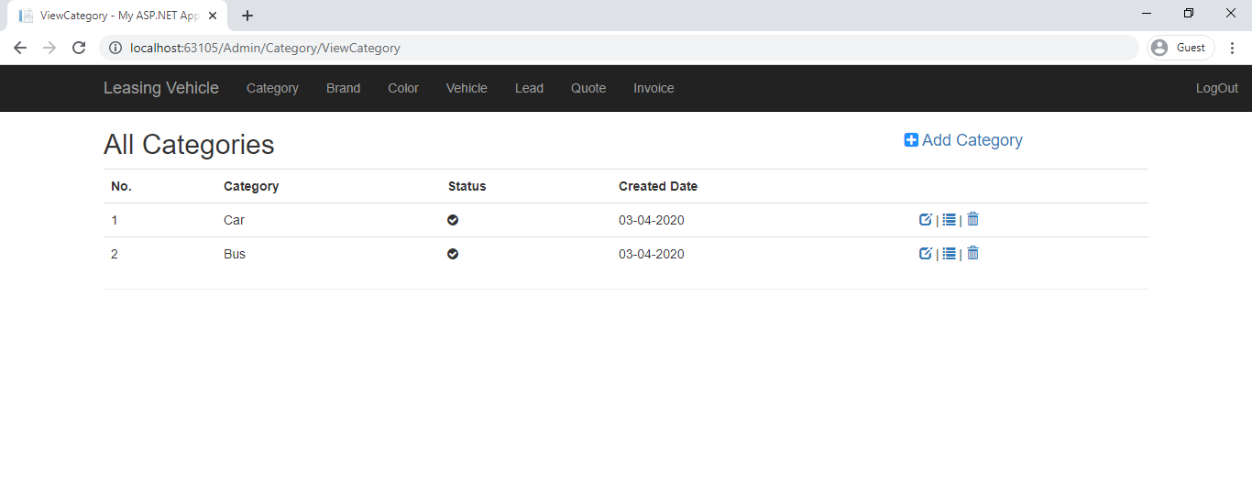
Category List
Category : Will display category list.
Add Category: Allows admin to add category in category list

Slide 33
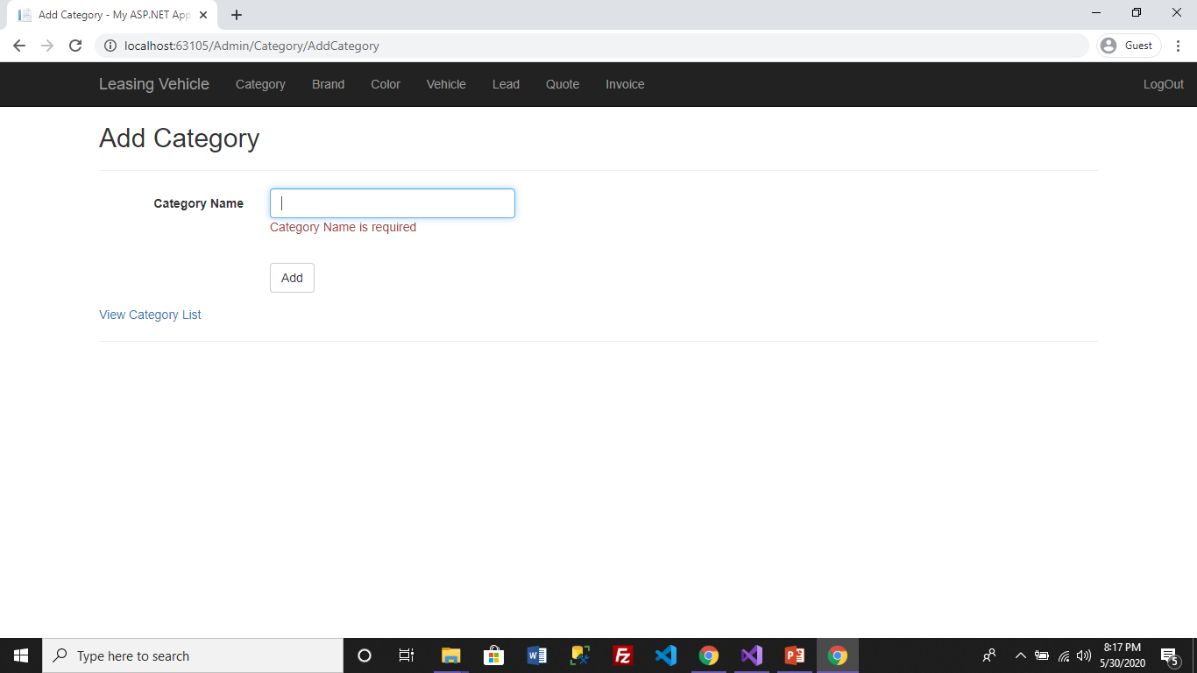
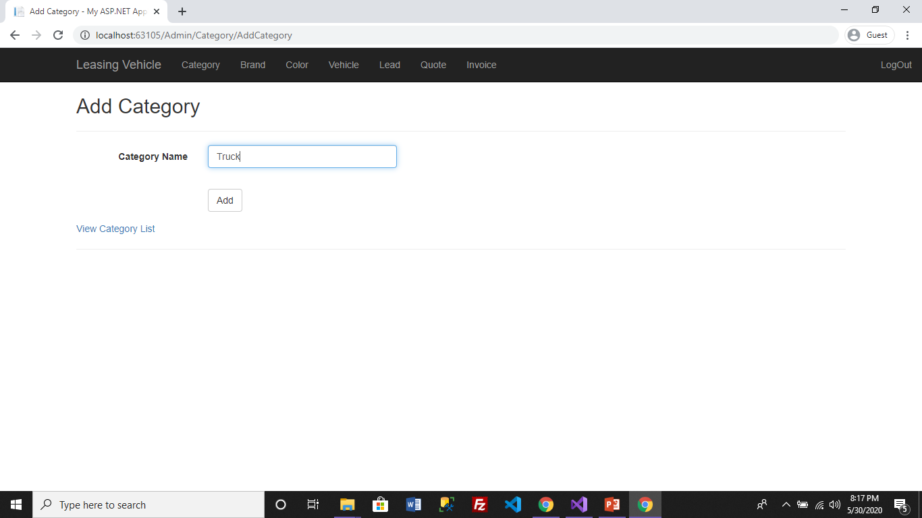
Add Category
Adding new category in category list.

Slide 34
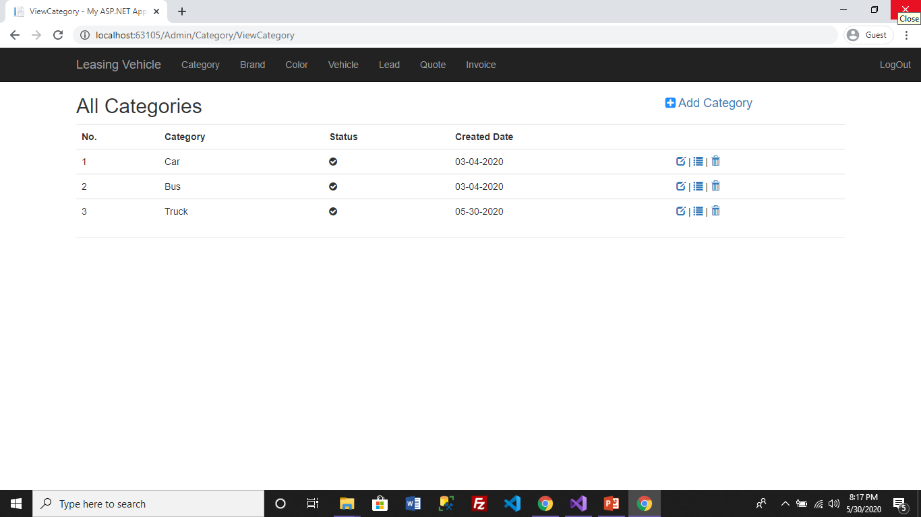
Category Added
Added
Edit | Details | Delete
Category added successfully.
Edit : Allows edit category details
Details : Show details of particular category.
Delete : It will delete category

Slide 35
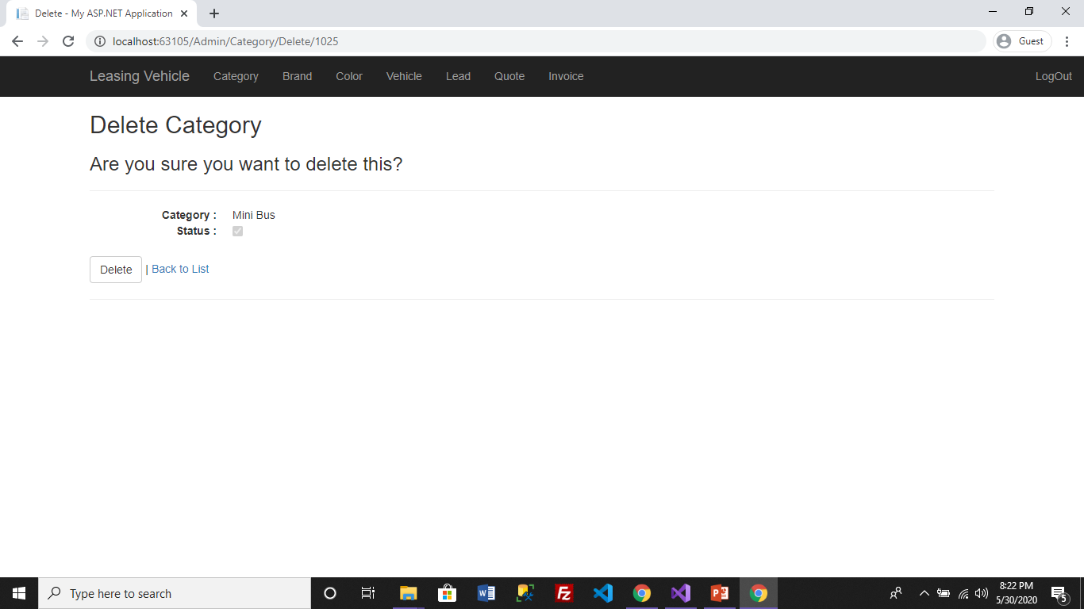
Delete Category
Delete Category from category list.

Slide 36

Category Deleted Successfully.

Slide 37
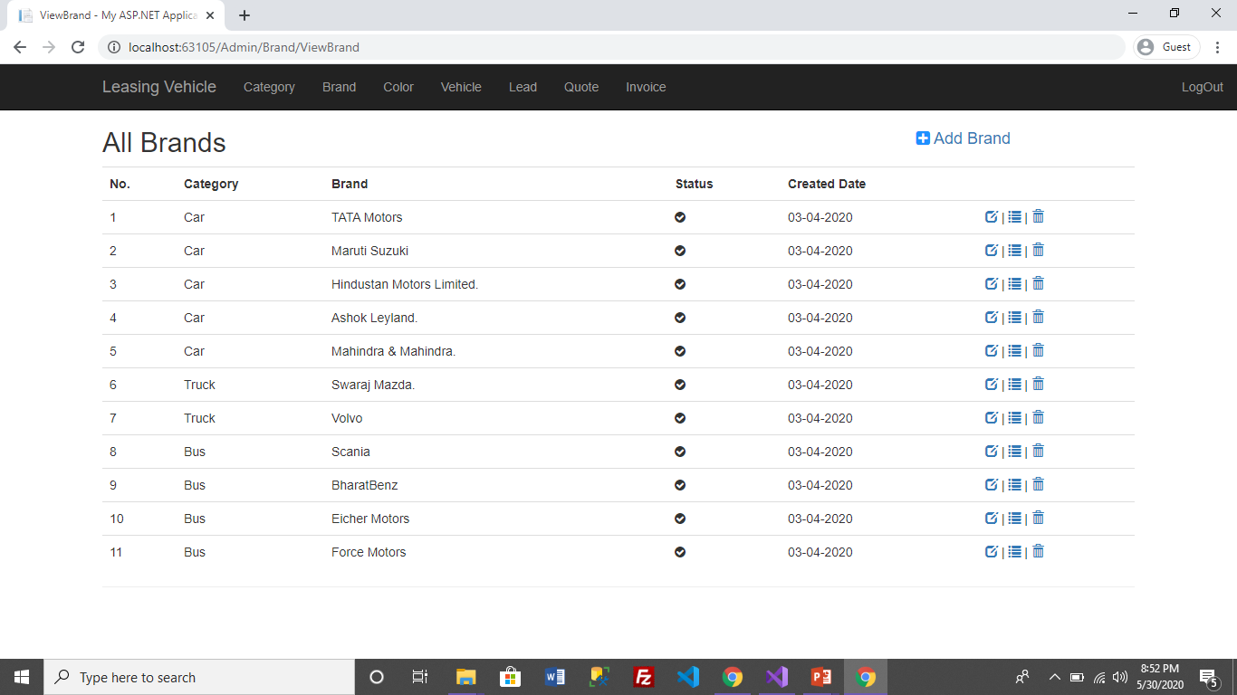
Brand List
Brand: When admin click on brand it will display brand list.

Slide 38
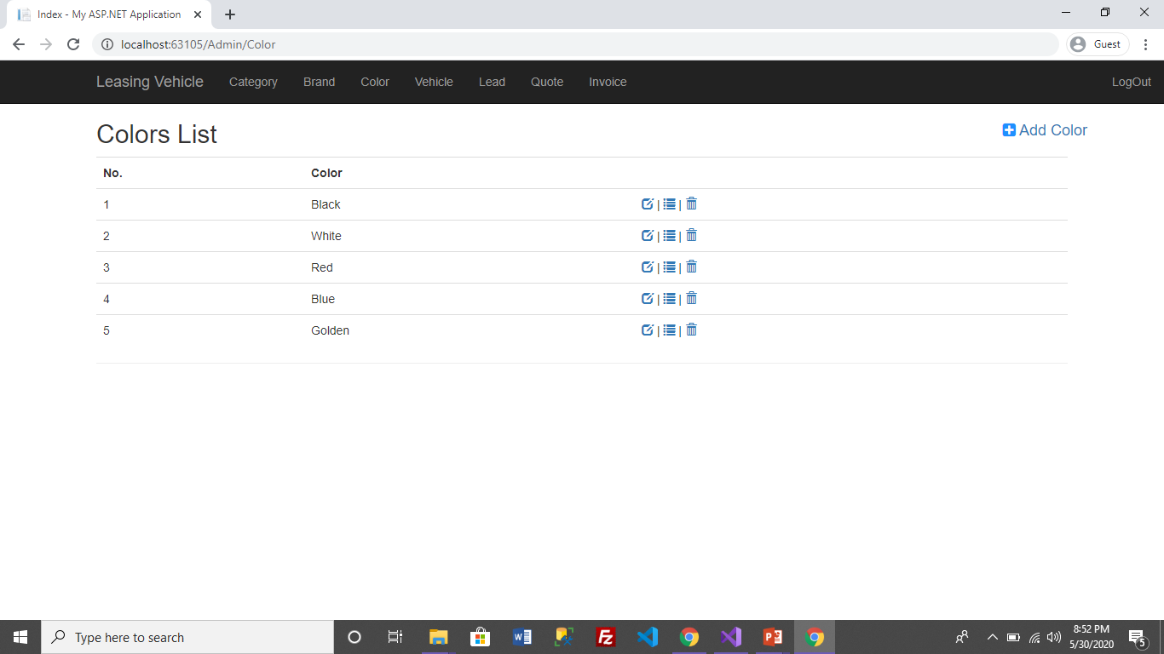
Colors List
Color : When admin clicks on color it will display color list.

Slide 39
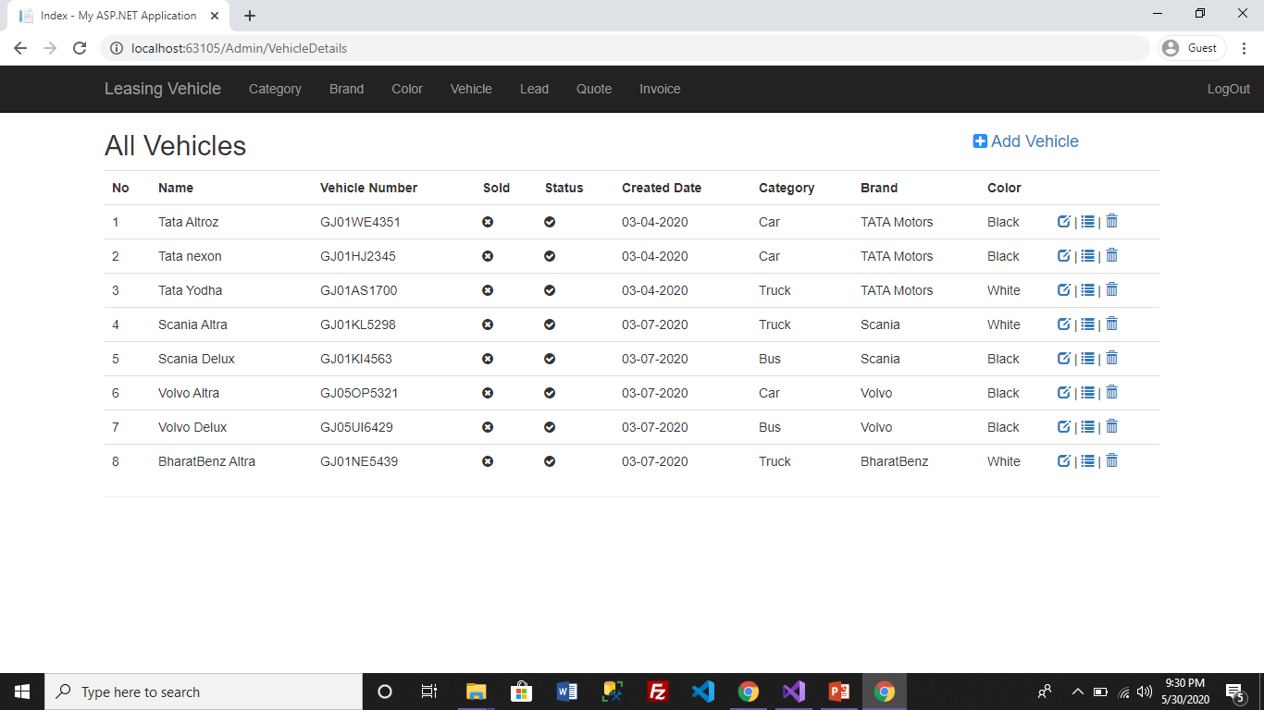
Vehicle List
Vehicle: It will display Vehicle list.
Add Vehicle: Allows admin to add new vehicle in vehicle list.

Slide 40
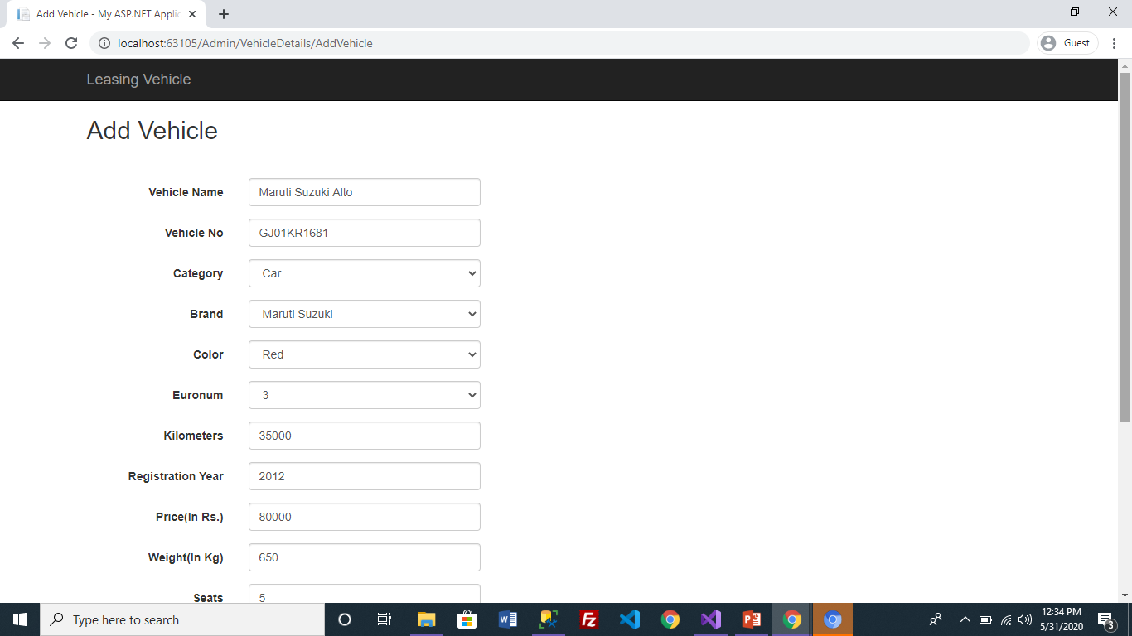
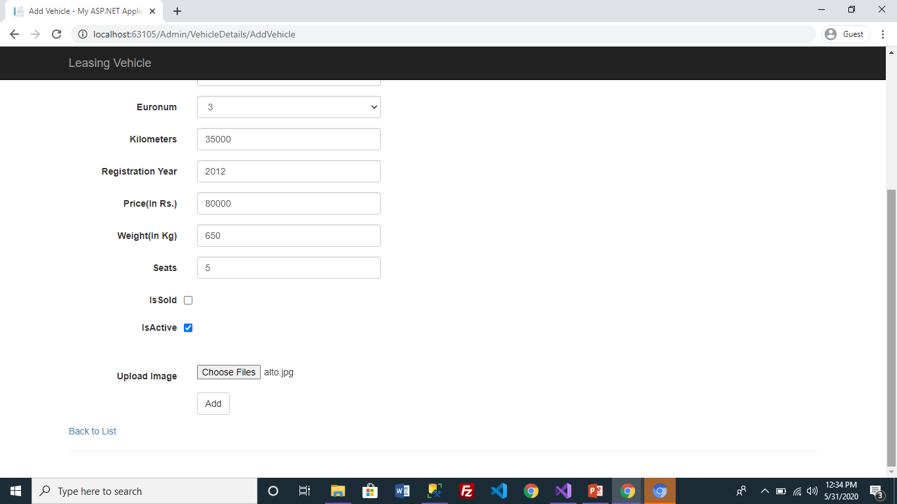
Add Vehicle
Adding vehicle details

Slide 41
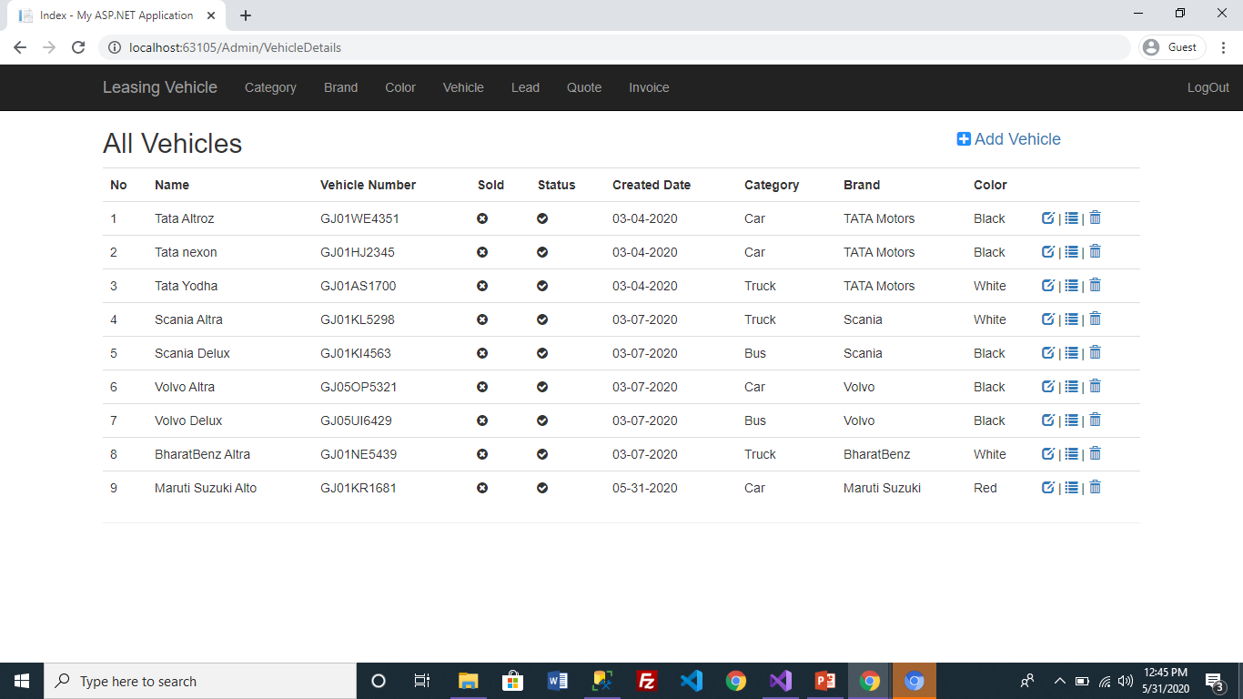
Vehicle Added Successfully.

Slide 42
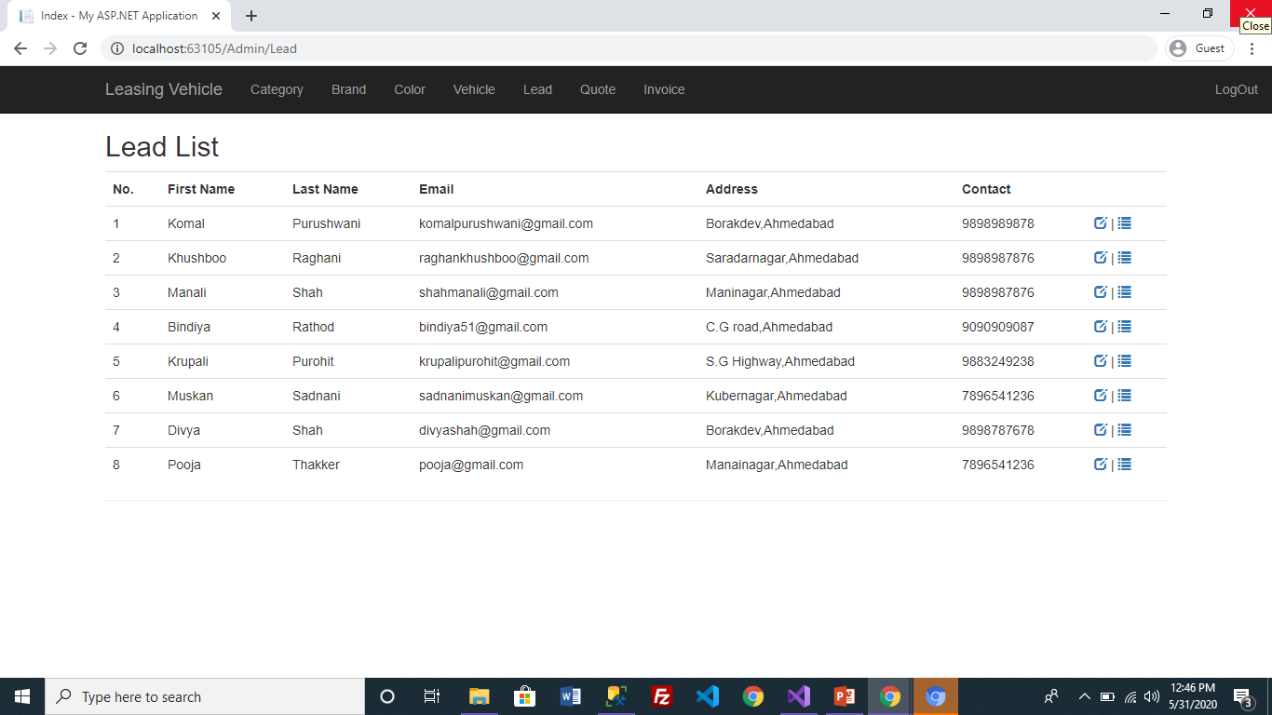
Lead List
Lead: When admin click on lead it will show total number of user registered with its details.

Slide 43
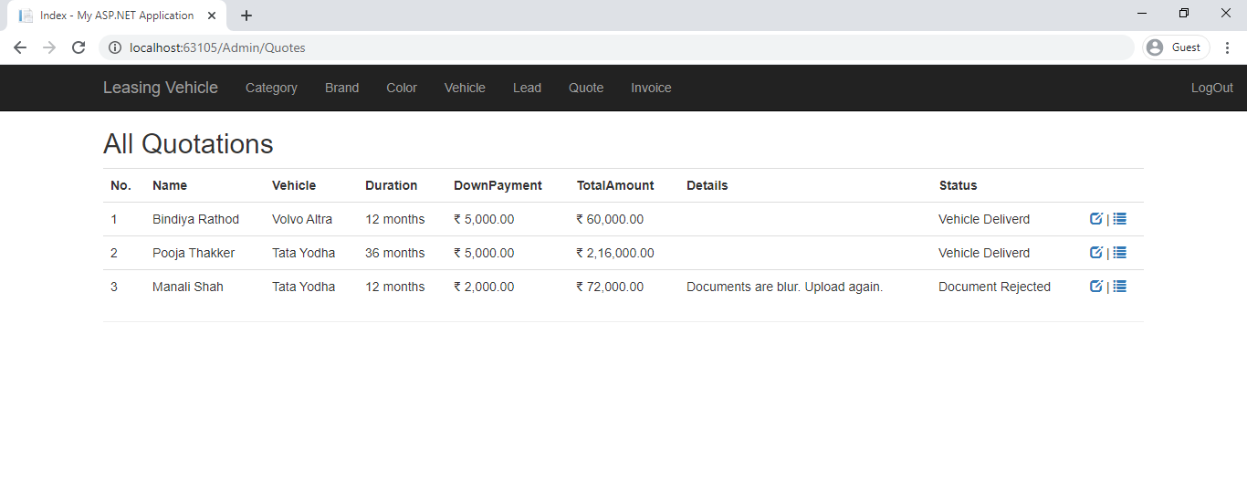
Quotation List
Status can be change by admin by clicking on edit quote details

Slide 44
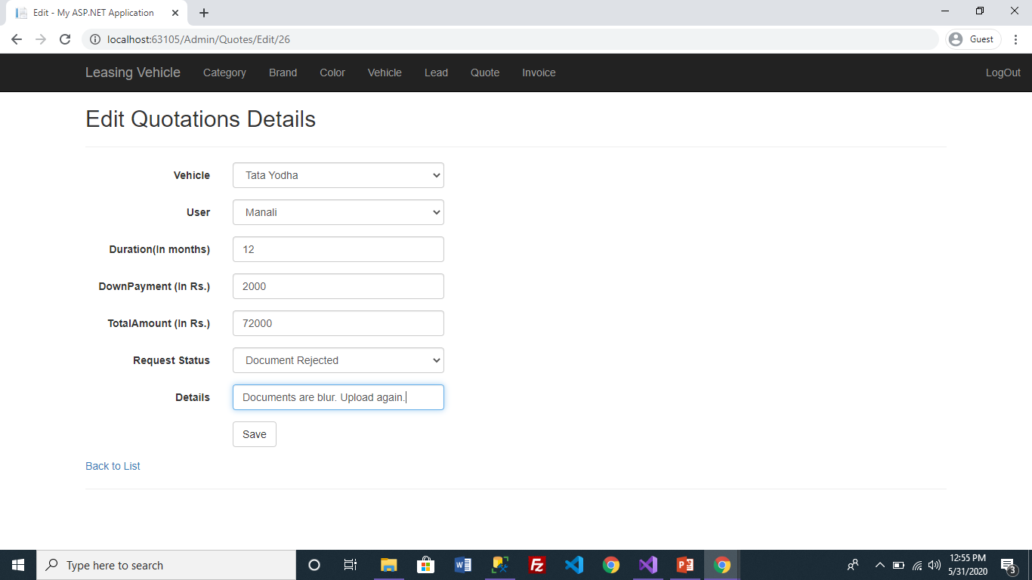
Edit Quote Details
Admin can update status as document updated to document verified .
Admin can also reject document by specify reason in details field.

Slide 45
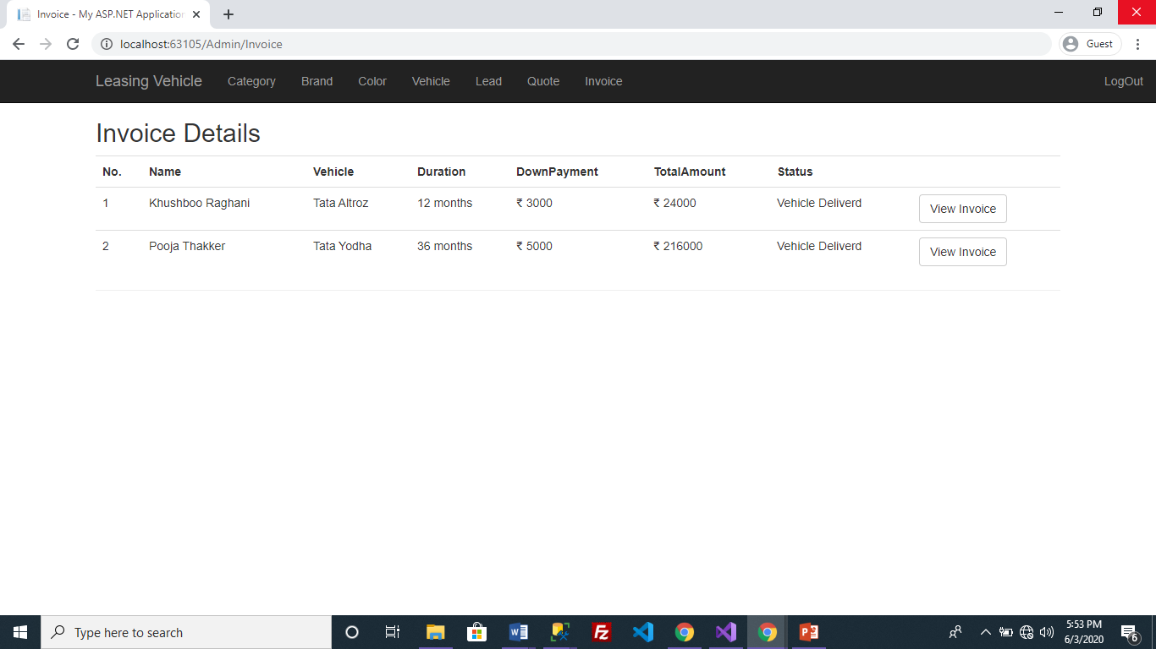
Invoice

Slide 46
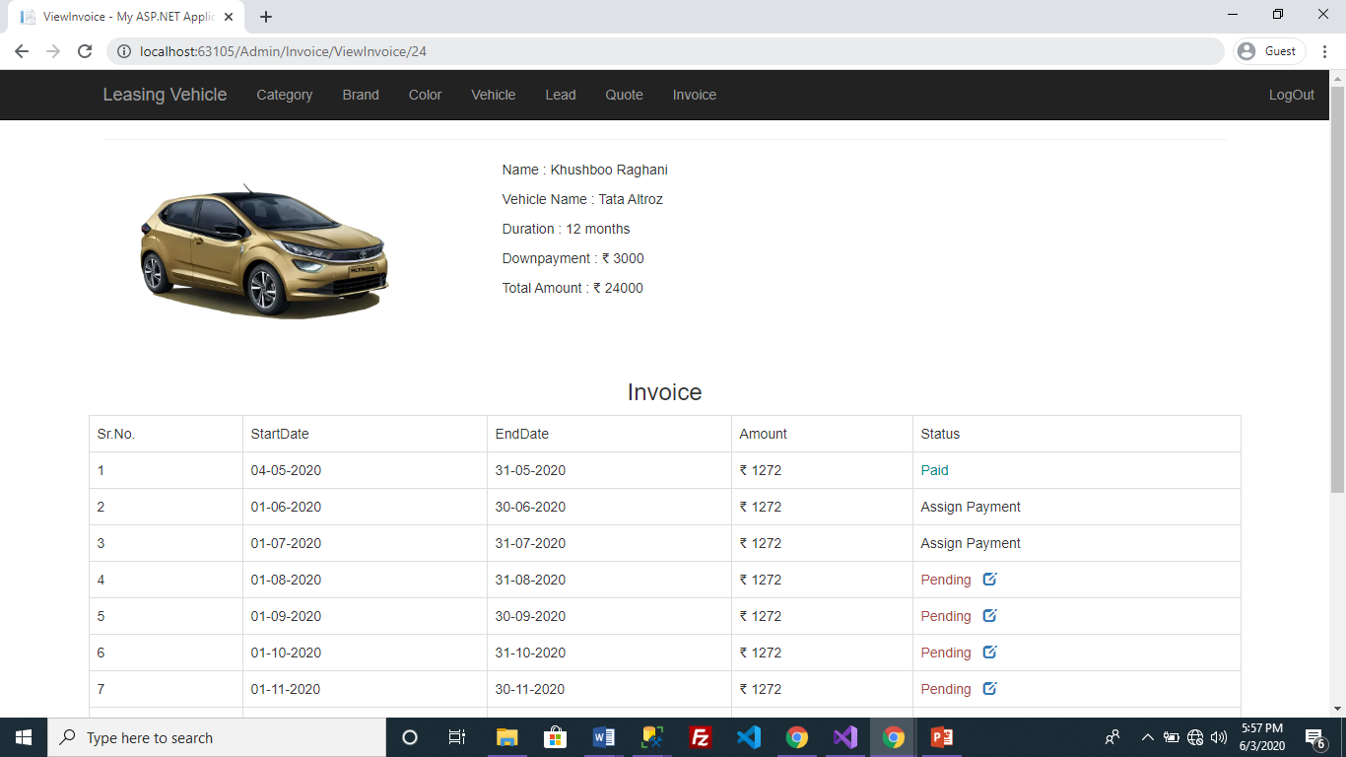
By Clicking on this status will change into Assign Payment from Pending.

Slide 47
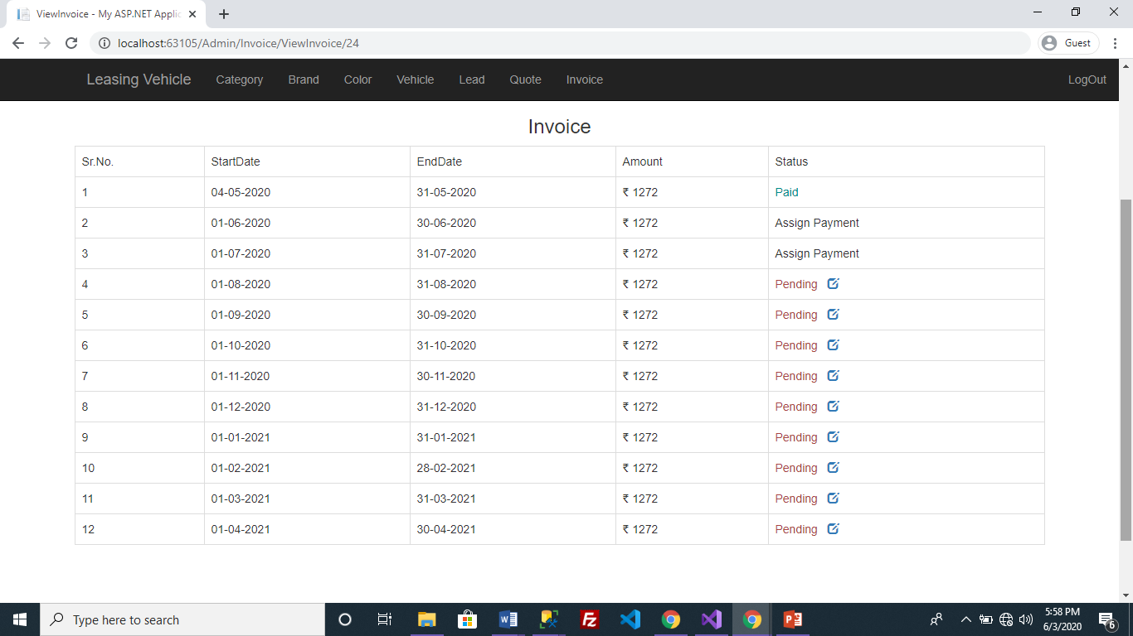

Slide 48
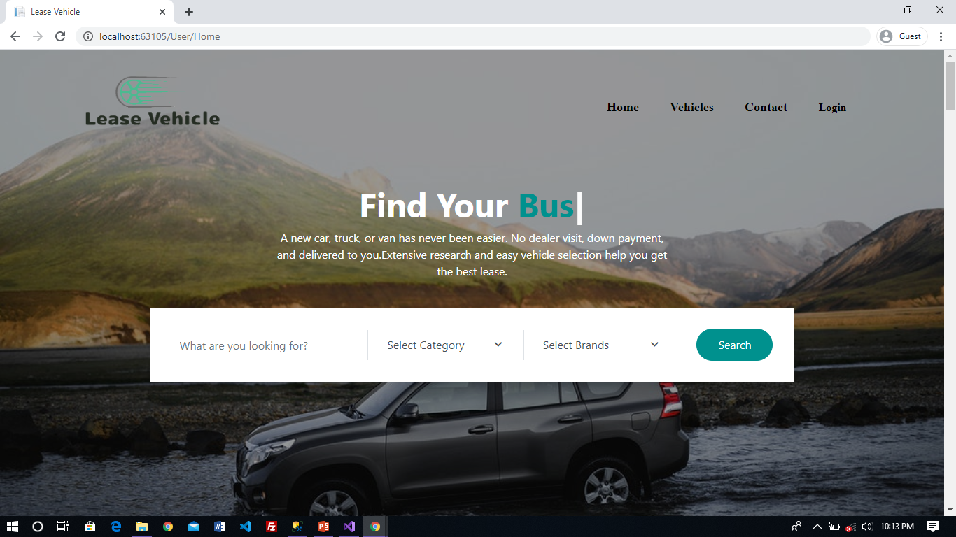
Screenshots : User Side
Home Page

Slide 49
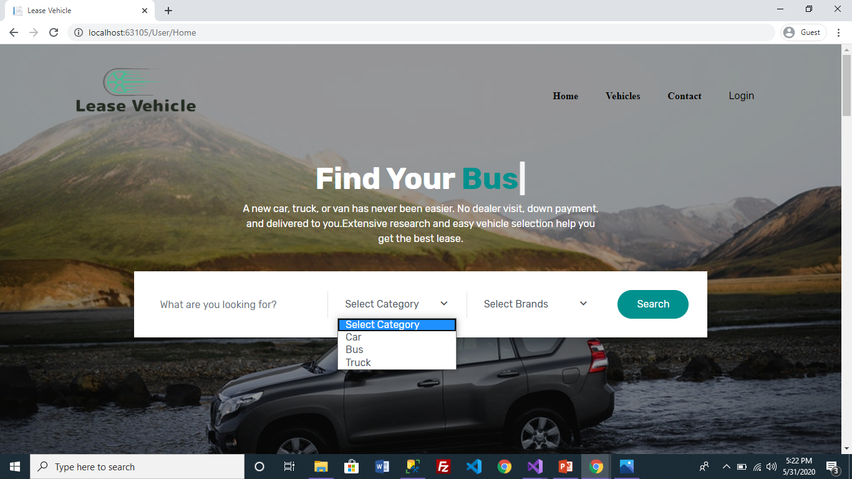
User select category from dropdown.
User can search vehicle by selecting particular category and brand.

Slide 50
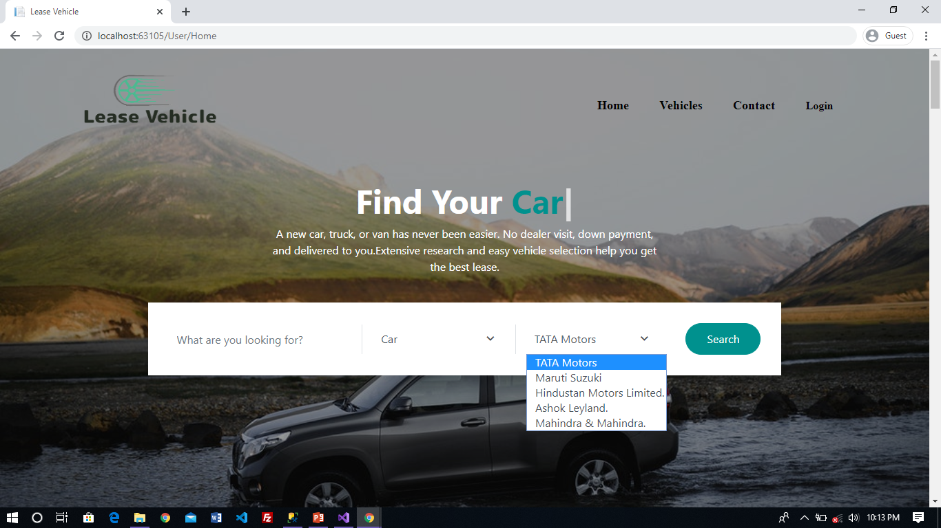
Models will display according to Category selected by user

Slide 51
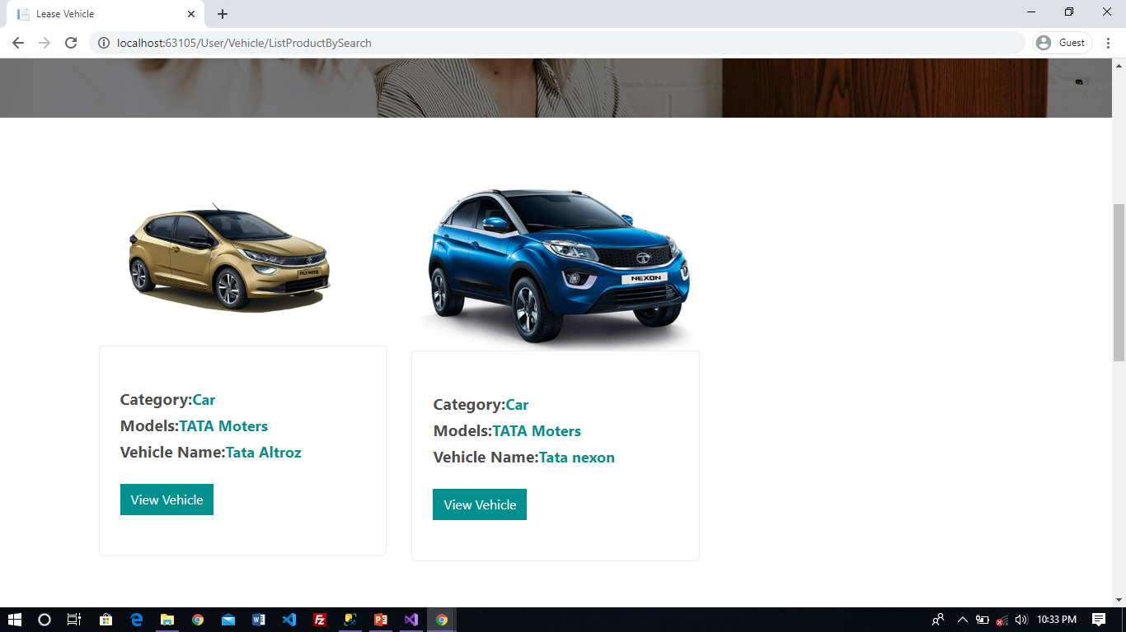
Result will display according to search
When user clicks on view vehicle will show details of that vehicle.

Slide 52
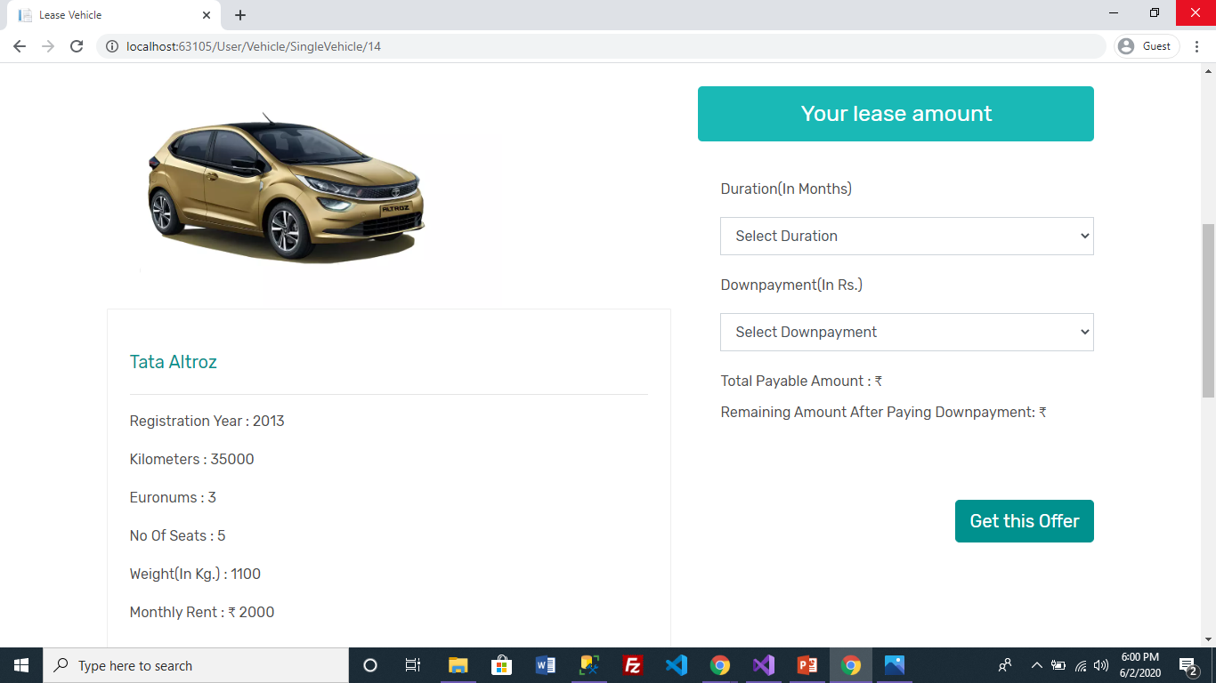
Single Vehicle Detail

Slide 53
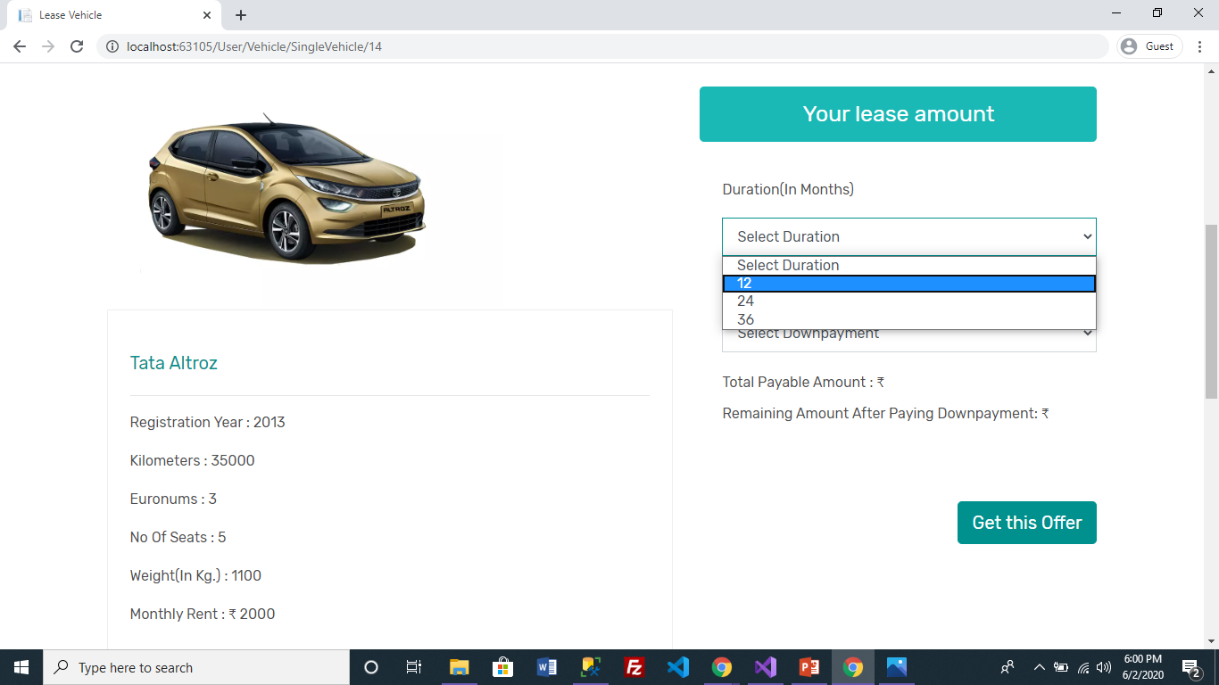
User Select Duration

Slide 54
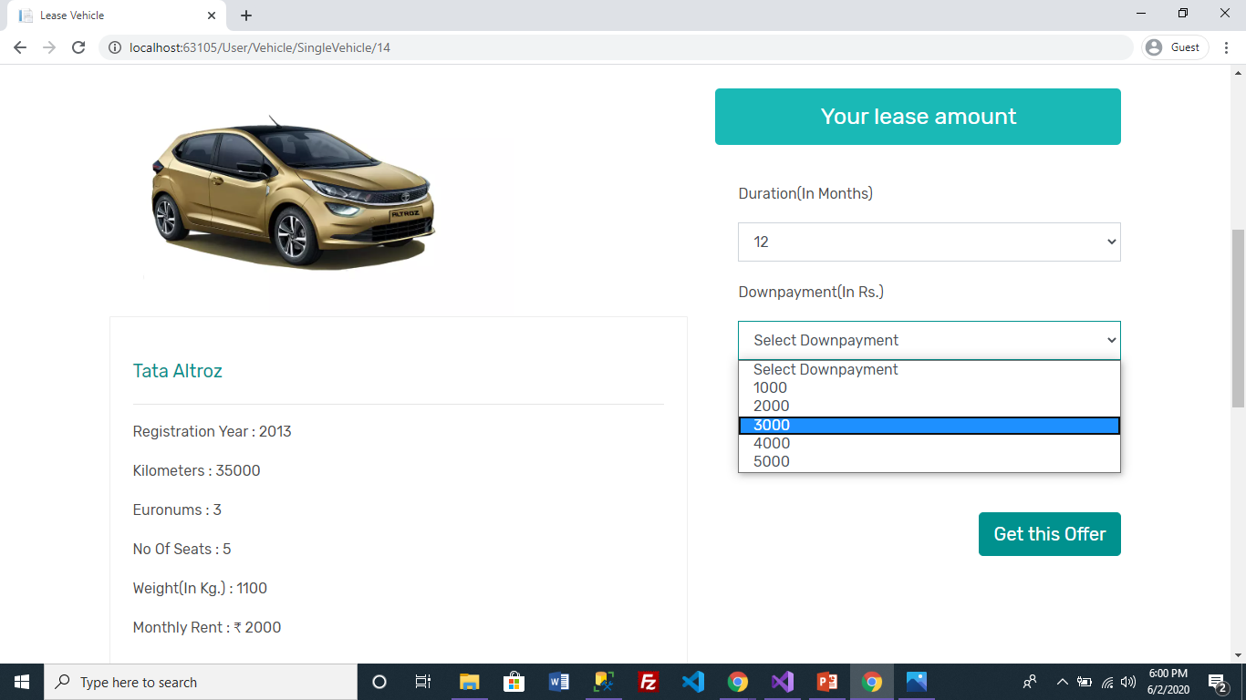
User Select Downpayment

Slide 55
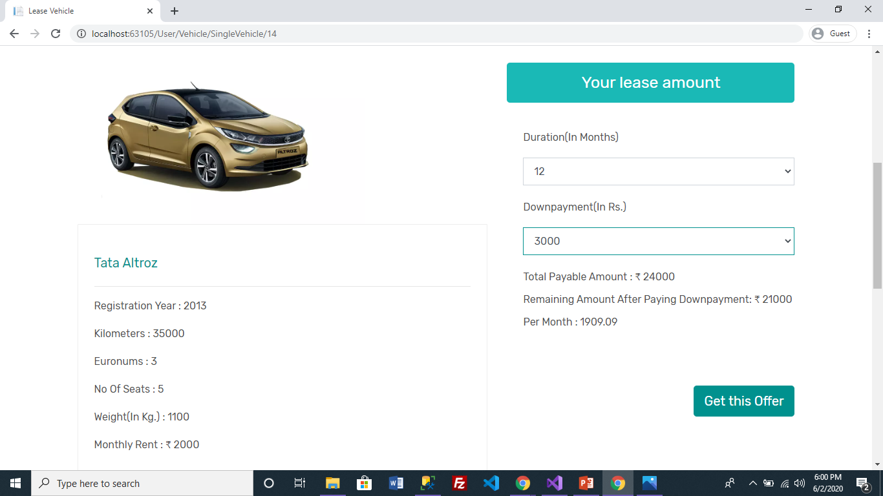
Get this offer send request to admin for vehicle

Slide 56
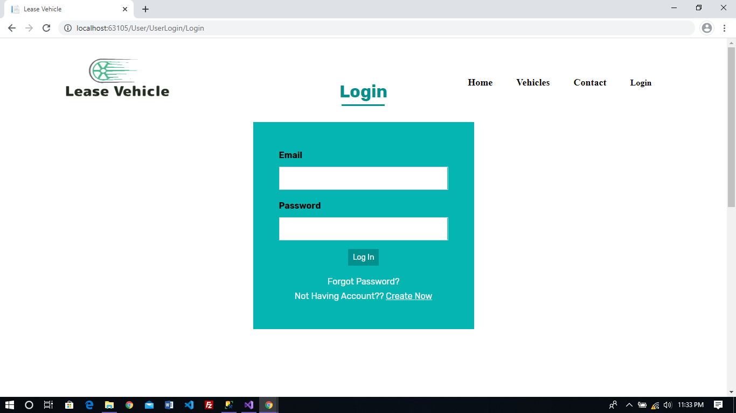
If user is new ,user can register by clicking on this link.
When user click on Get this Offer , request for vehicle will accepted when user is login.
If user is not login it will redirect to login page.

Slide 57
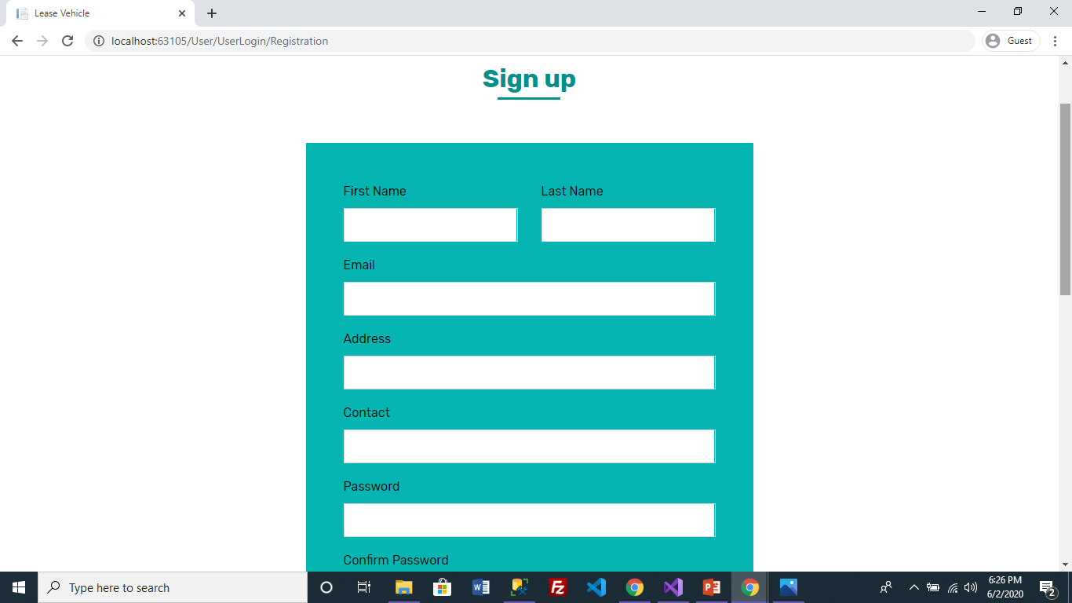
Registration form

Slide 58
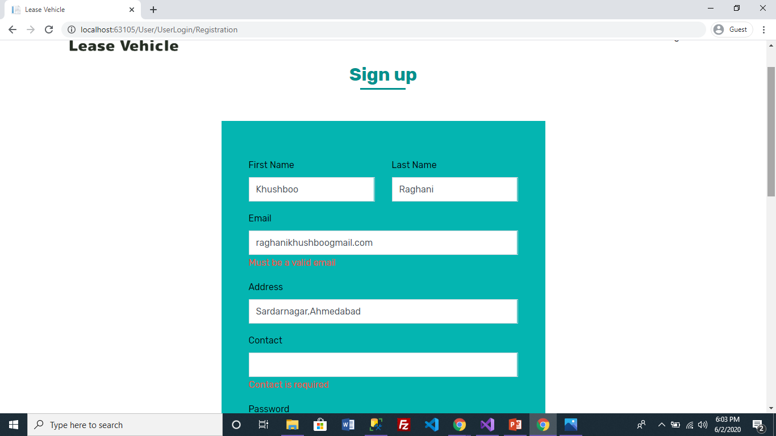
Validation of Registration Form

Slide 59
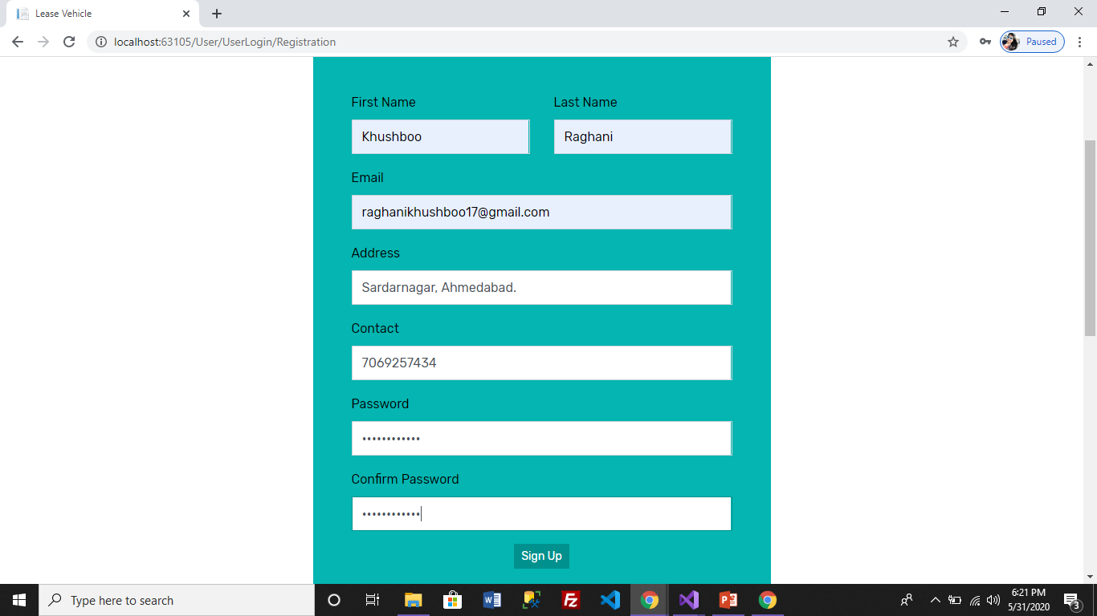
Registration Form

Slide 60
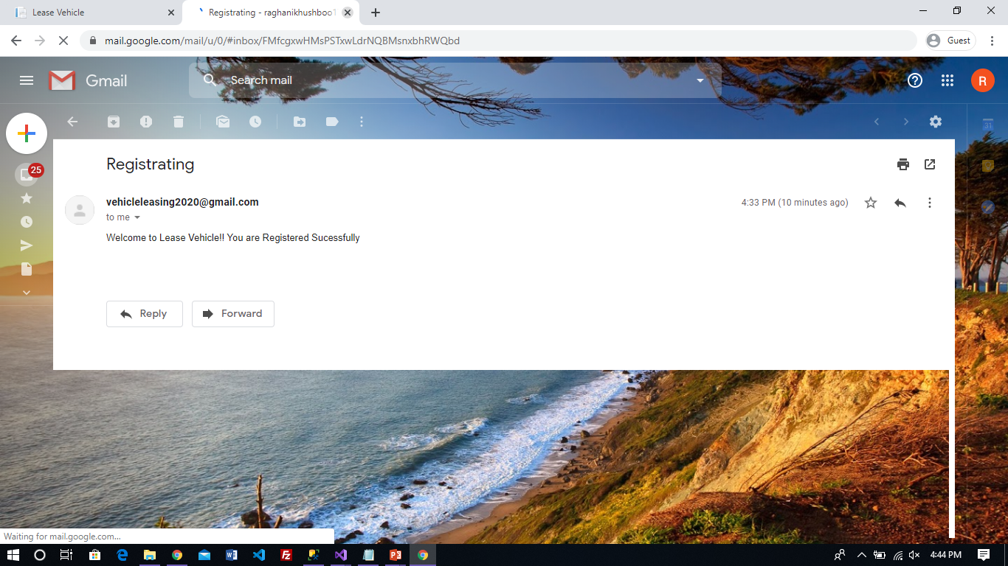
User Register Successfully
When User successfully register ,email will send to their register Email Id.

Slide 61
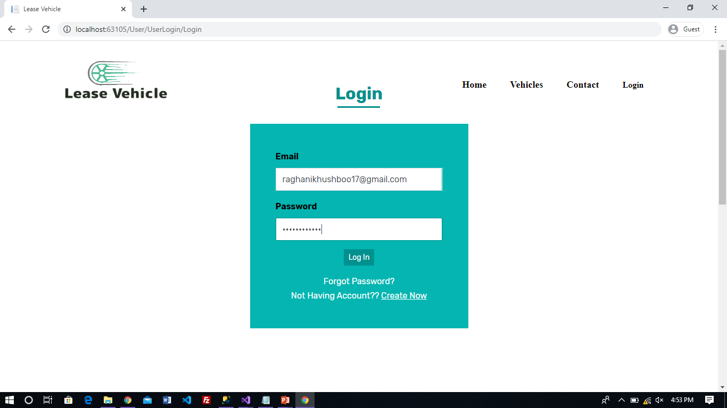
Login
This page allows user to login .If username or password is incorrect it will give message as invalid username and password. Here , Both fields are required.

Slide 62
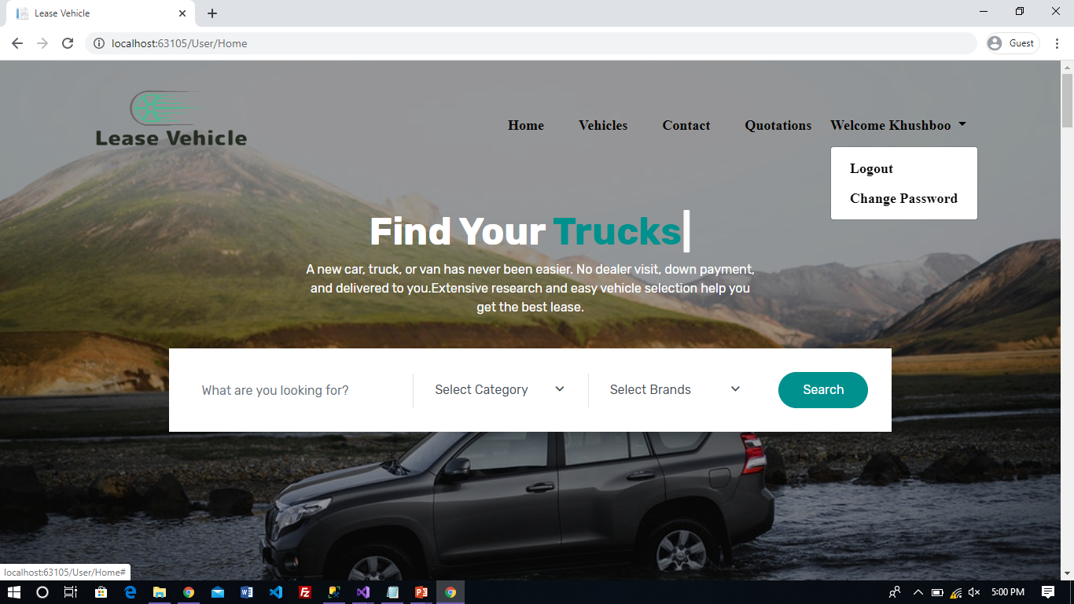
Login Successfully Done
When login successfully done it shows name of user in top right side

Slide 63
Here,
Vehicles: Will display all vehicles
Contact: Will display for contact to know more details
Quotations: Will display all quotations of vehicle according to user requested them.

Slide 64
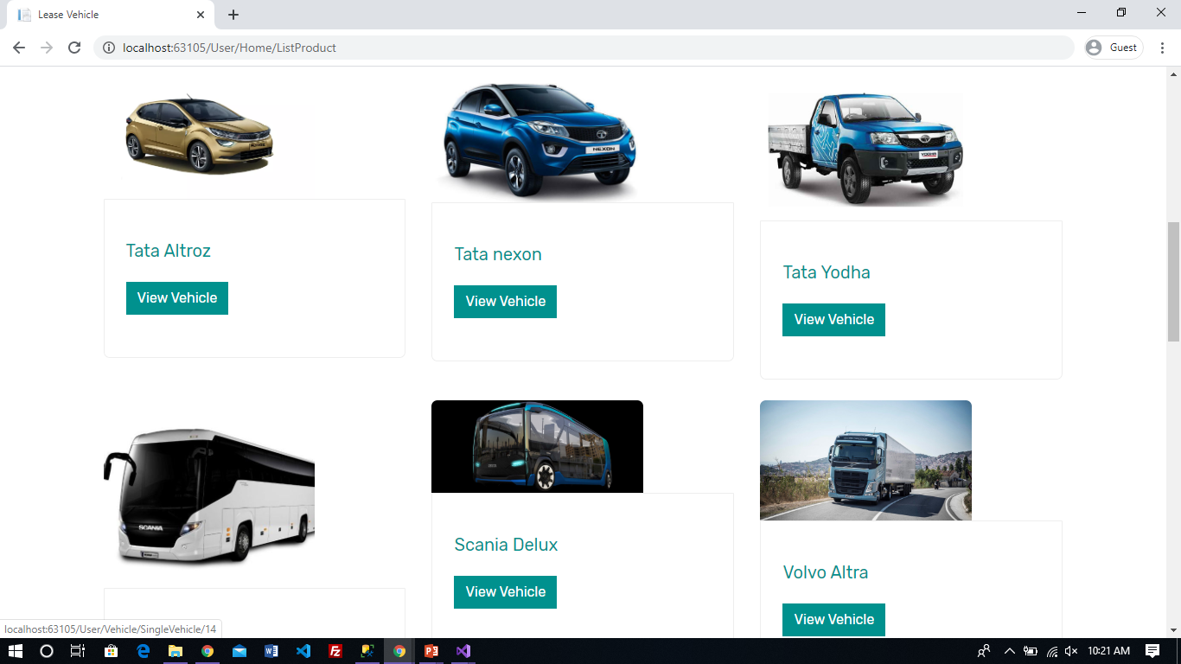
All Vehicles

Slide 65
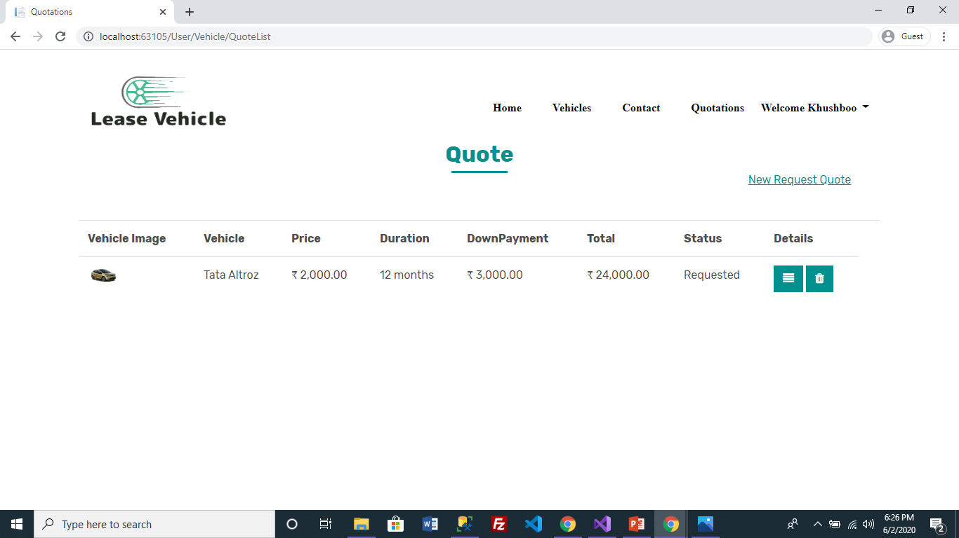
Quotations
User can request for new quote here
0
Details | Delete
User can delete quote request when status is Requested else only view details and do others operation like upload documents , payment , etc.

Slide 66
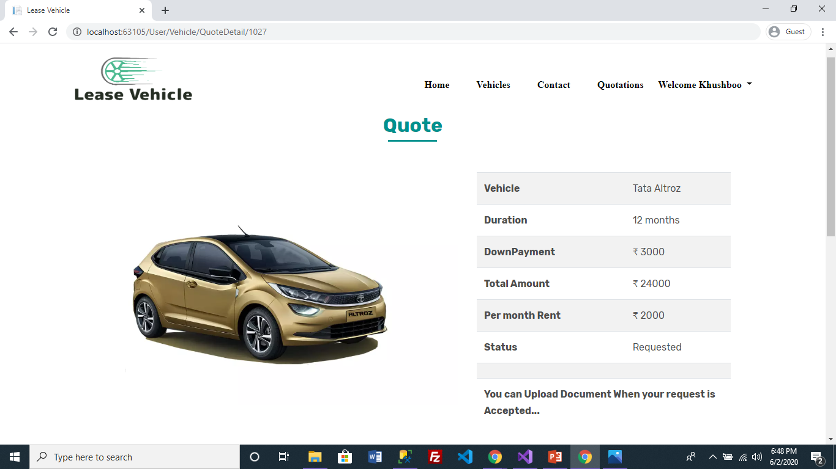
Quote Details
When user clicks on details on page Quote List it will display details of particular quote.

Slide 67

Status Changes into Accepted now user can upload their documents.

Slide 68
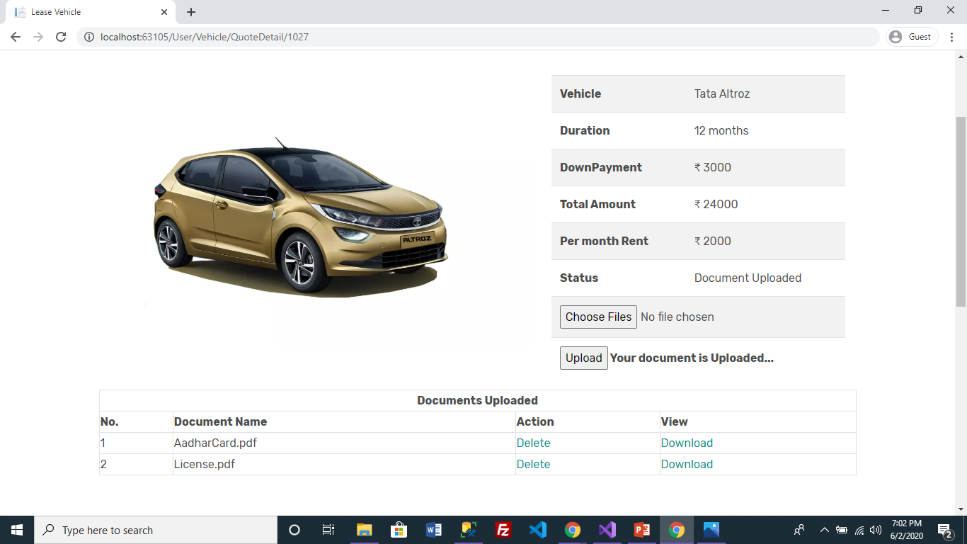
Document uploaded by user successfully.

Slide 69
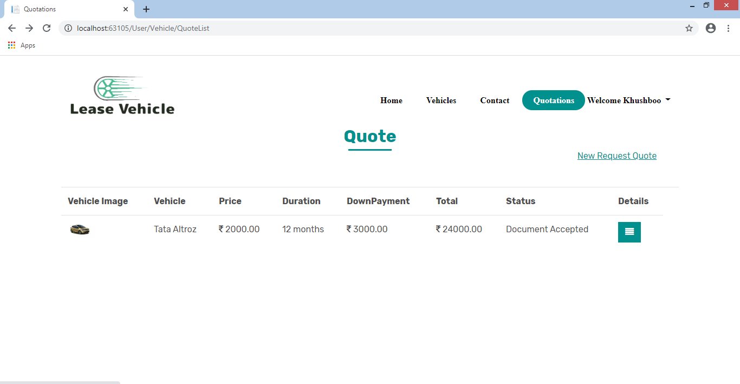
When Document Approved by Admin status changed into Document Accepted.

Slide 70
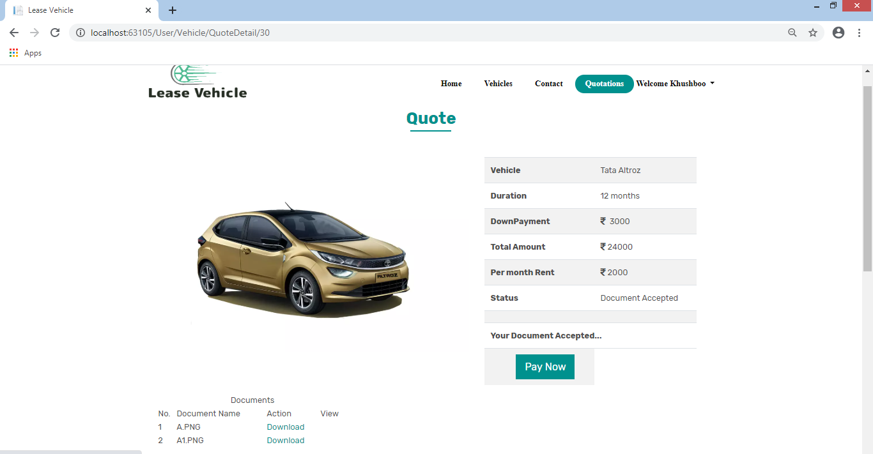
Redirect to payment gateway
When Status Changed into Document Accepted User can pay Downpayment.

Slide 71
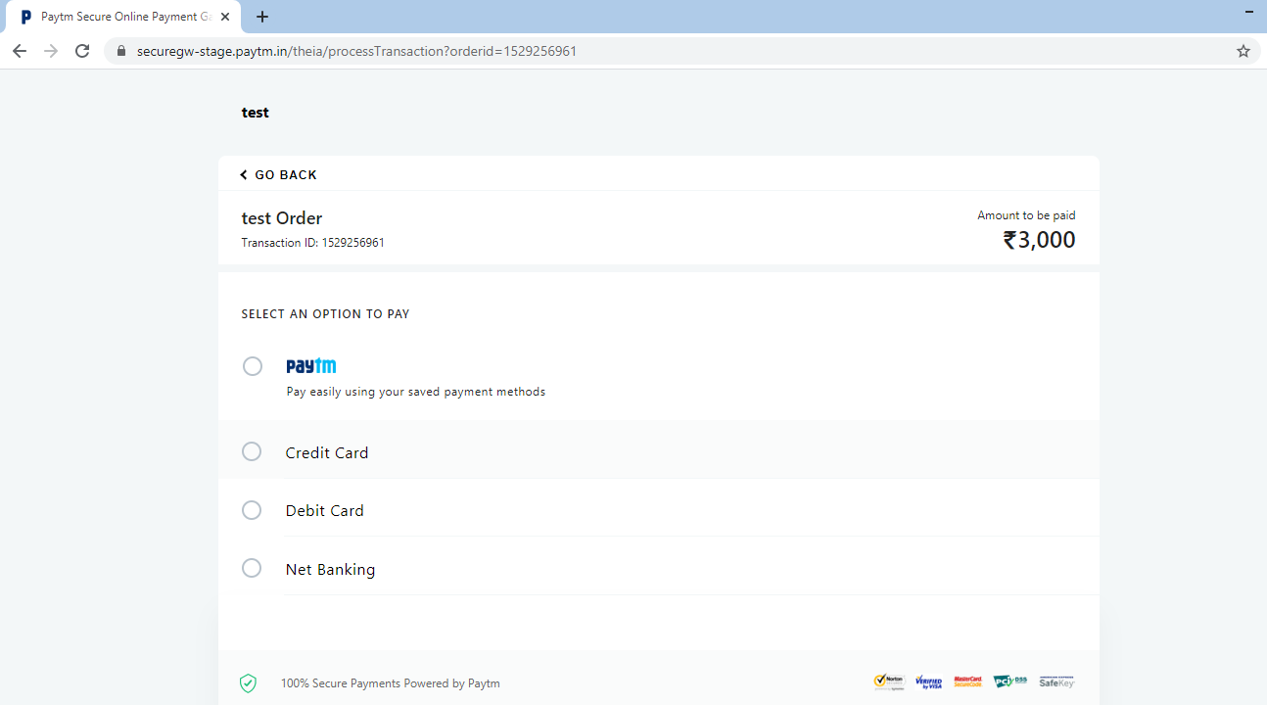
When user click on PayNow it will redirect to Paytm payment gateway.
User can pay through various way like paytm wallet,credit card, debit card,etc

Slide 72
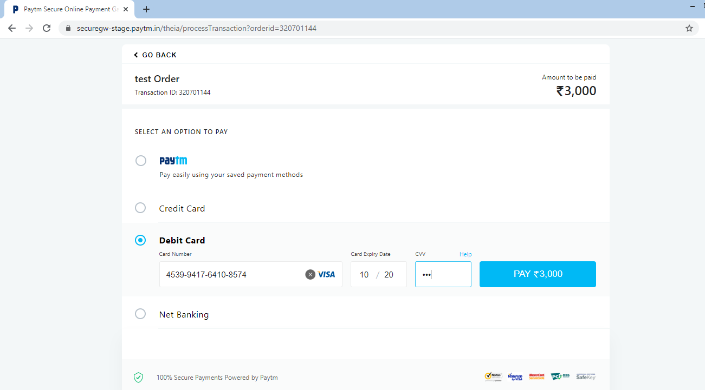

Slide 73
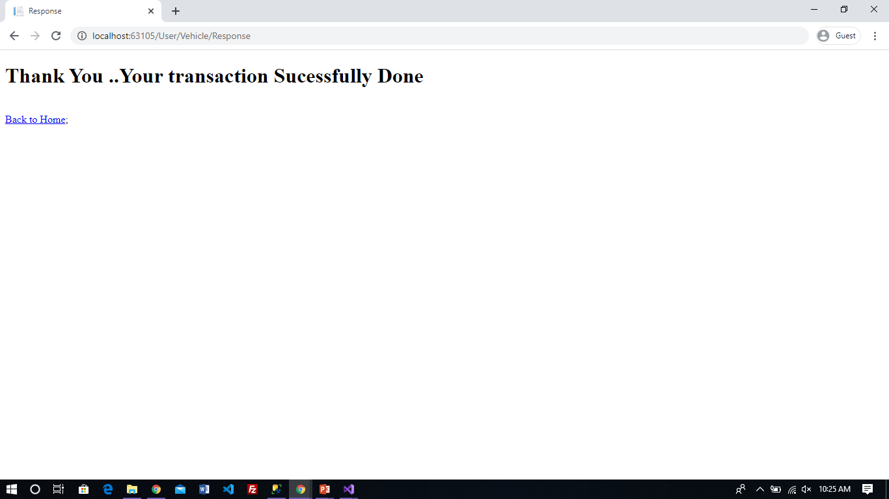
When transaction done successfully it redirect to success page.

Slide 74
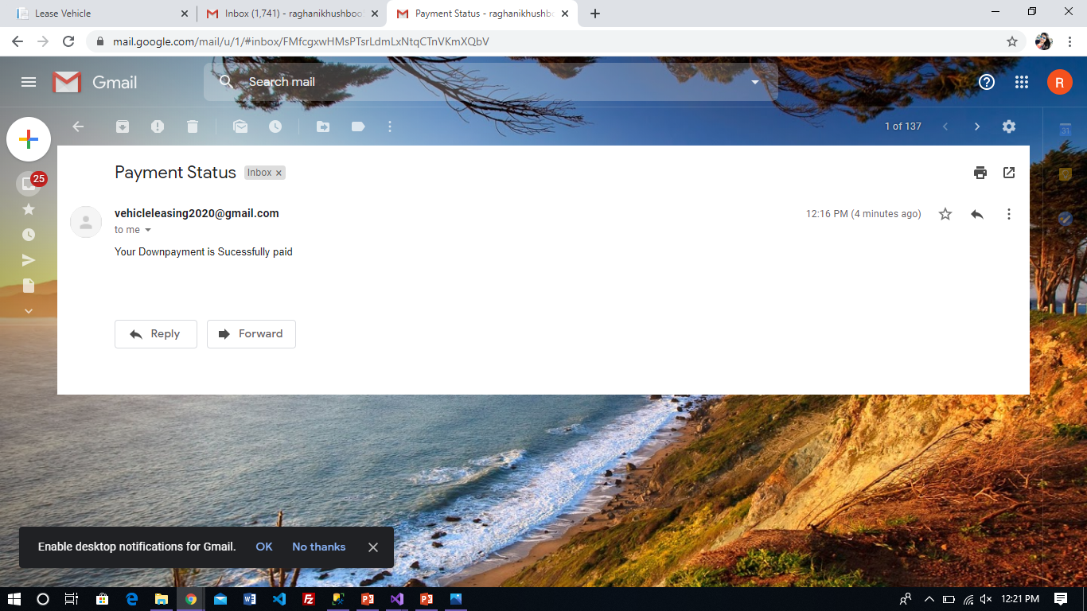
Mail will be send to user for payment successfully done.

Slide 75
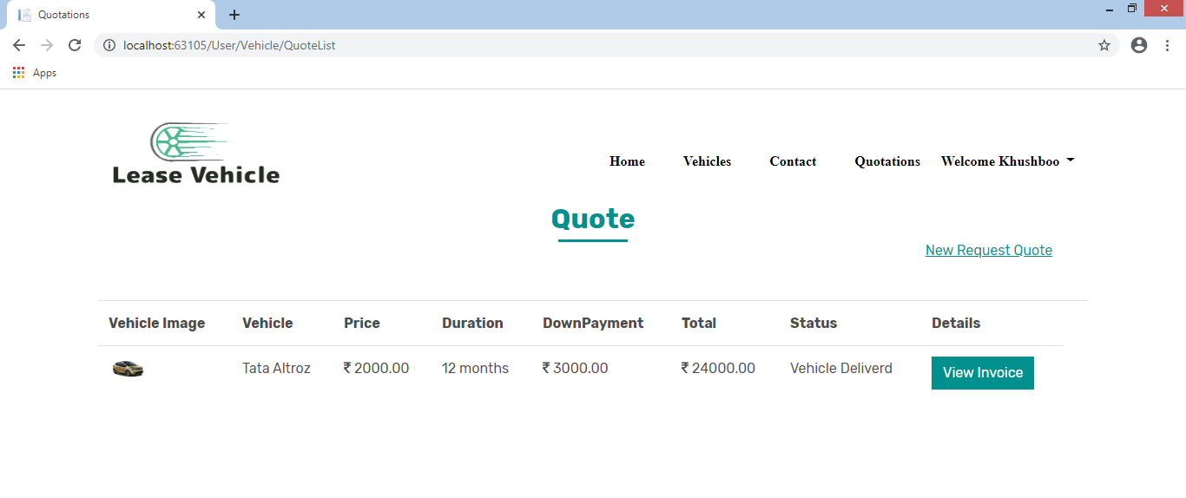
When downpayment success status will change into Vehicle Delivered
User can also view invoice

Slide 76

Invoice

Slide 77

Every month user have to pay remaining payment in installments.

Slide 78

When user done with all installments status will changed into Order Completed.

Slide 79


Slide 80
Change Password
When User click on Change Password . It redirect to form of change password

Slide 81


Slide 82
Forgot Password

Slide 83


Slide 84

New Password will sent to user registred email id.

Slide 85

Contact Us

Slide 86


Slide 87
Test Cases
Test Case 1: Admin Login
Test Case | Test Data | Excepted Result | Actual Result | Status
Admin login | Enter username & password | Login successful and redirect to admin dashboard | As expected | Pass
Admin login | Enter username & password | Login successful and redirect to admin dashboard | Error: Enter valid username or password | Fail

Slide 88
Test Case 2: User Login
Test Case | Test Data | Excepted Result | Actual Result | Status
User login | Enter username & password | Login successful and redirect to Home Page | As expected | Pass
User login | Enter username & password | Login successful and redirect to Home Page | Error: Enter valid username or password | Fail

Slide 89
Test Case 3: Change Password
Test Case | Test Data | Excepted Result | Actual Result | Status
Change password | Enter Old , new and confirm password | Change successful and redirect to Home Page | As expected | Pass
Change Password | Enter Old , new and confirm password | Chang successful and redirect to Home Page | Error: Old password is incorrect | Fail

Slide 90

Reports

Slide 91


Slide 92


Slide 93


Slide 94


Slide 95


Slide 96


Slide 97


Slide 98


Slide 99


Slide 100


Slide 101


Slide 102
Thank you

